Slide 1


Olist Sales analytics
Dashboard
Data Vision
(143)
DEPI

Slide 2
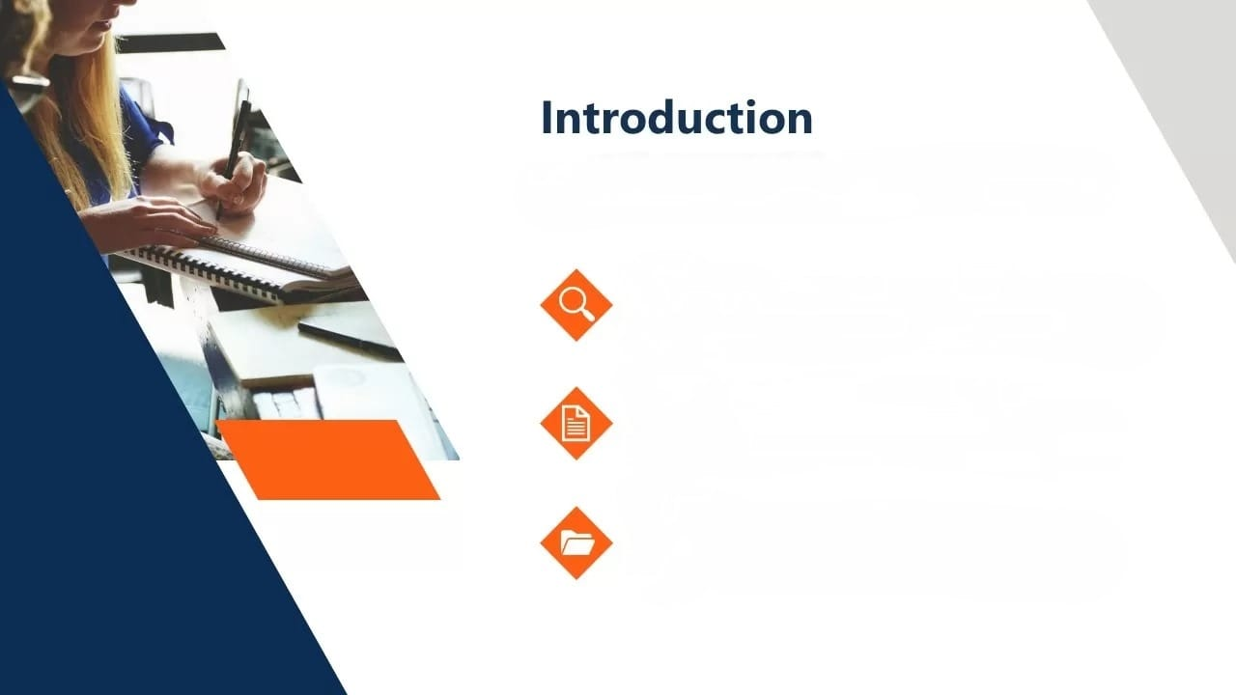
I
Introduction
Our team an interactive sales analytics dashboard for Olist e-commerce platform. This dashboard transforms sales data into actionable insights, enabling stakeholders to monitor performance, identify trends, and make informed business decisions.
Analyze
Deep dive into Olist sales data and customer behavior patterns.
Visualize
Interactive dashboard with real-time metrics and performance indicators.
Optimize
Data-driven insights for better business decisions and growth strategies.

Slide 3

Data Cleaning
Youssef Mohamed
Our
Approach
Measures selection
Ahmed Walied
Visualization
Youssef Mohamed
Presentation
Fares Mamdouh
Mohamed Adawy

Slide 4

Project Objectives
Visualize sales performance across different dimensions Identify key trends and patterns in customer behavior Analyze product categories and their performance Provide insights for data-driven business decisions Create an interactive and user-friendly dashboard

Slide 5
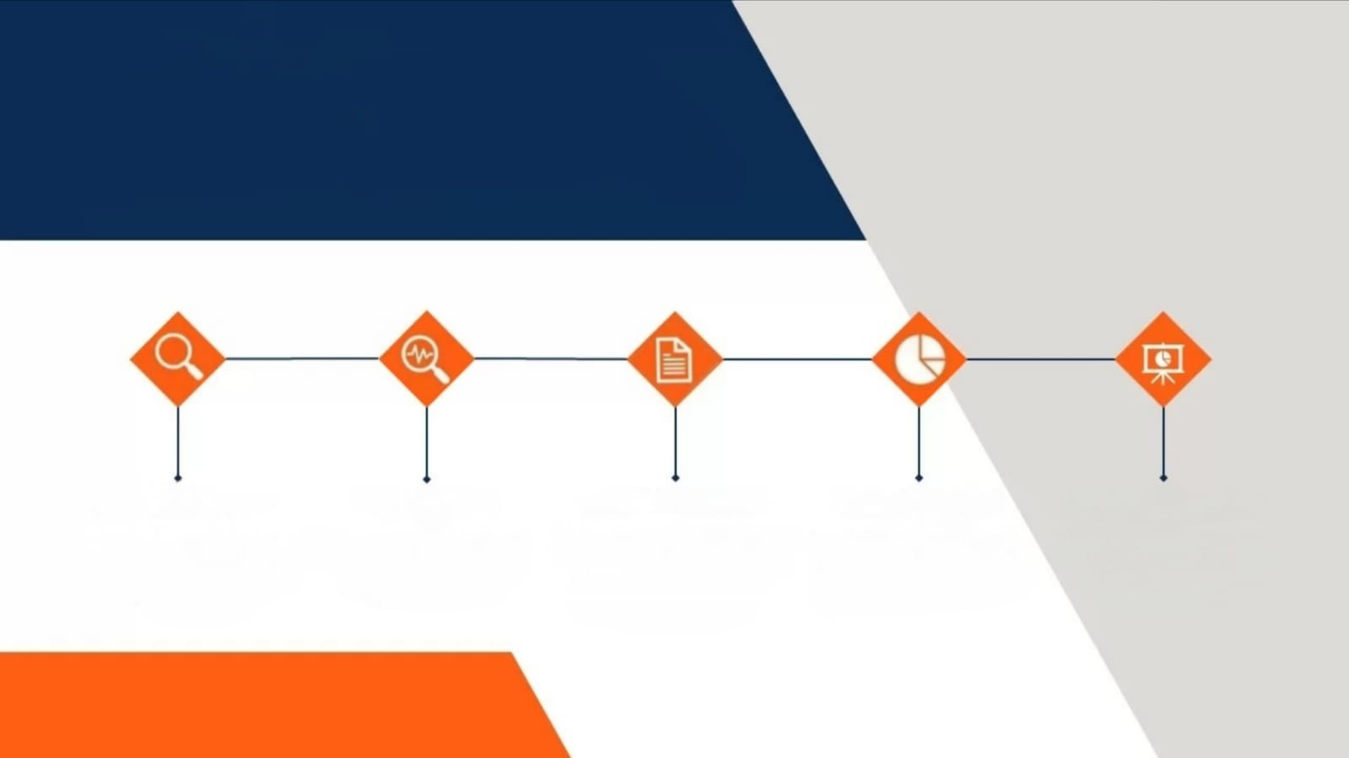
Methodology
Data Collection
& Understanding
Data Cleaning
Measures
Selection
visualization
interpretation

Slide 6
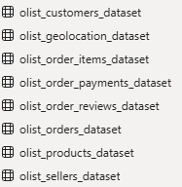
Data collection
& Understanding
Our analysis incorporates comprehensive Olist transaction data including
📊 customer ID , seller ID , customer unique ID
🌍 customer city , customer state , ZIP code , geolocation city
🛒 order ID , order item ID
📦 product ID
💳 price, payment value , freight value , payment type
📋 shipping date, review date , order status , delivery date , review score

Slide 7

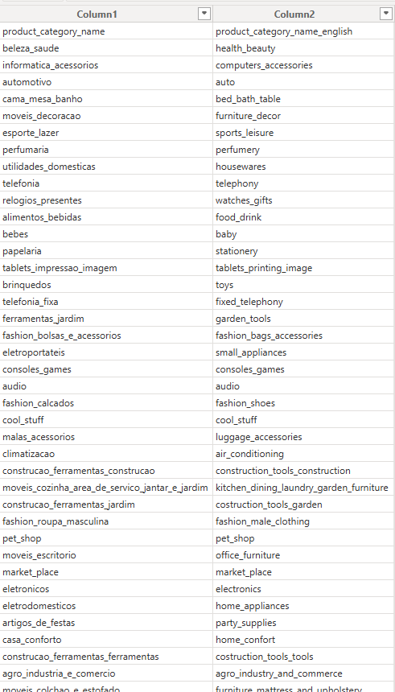
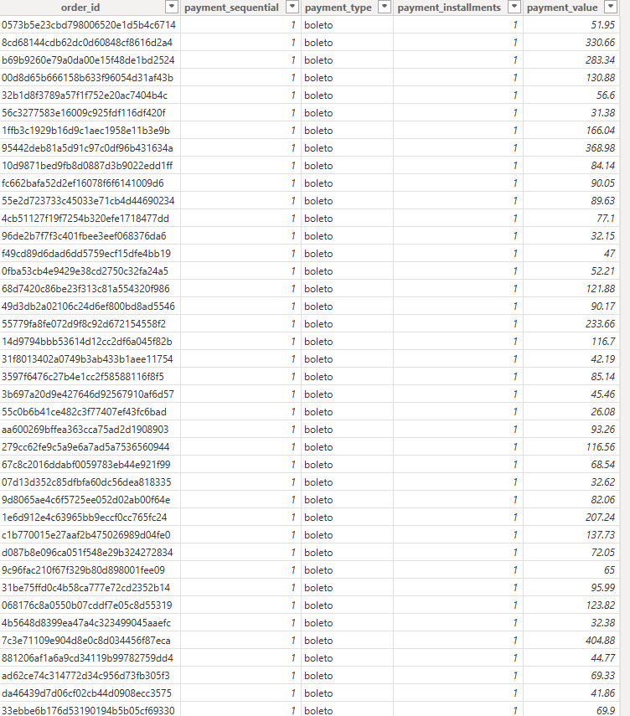
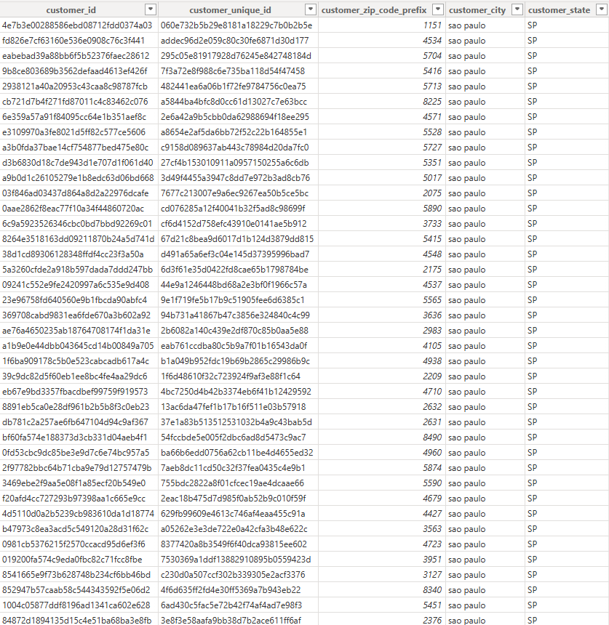
Data collection
& Understanding

Slide 8
Data Cleaning
Data Cleaning Using SQL Server
We utilized SQL Server to perform comprehensive data cleaning operations including handling null values with Connection Function , Detection Function , Main Function and Data Cleaning Function functions, removing duplicates using ROW_NUMBER() and CTE queries, and standardizing inconsistent entries through UPDATE statements. SQL queries enabled efficient identification and correction of data quality issues across millions of records, ensuring clean and reliable data for analysis.

Slide 9
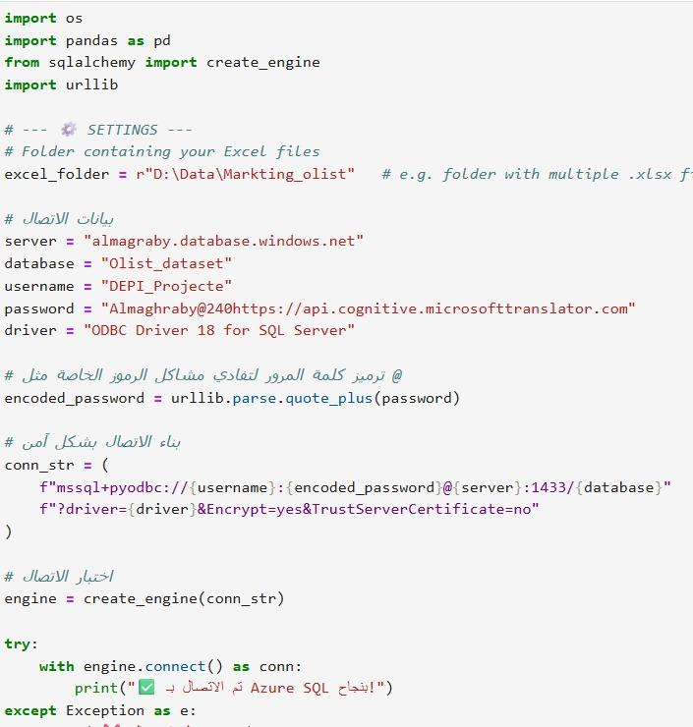
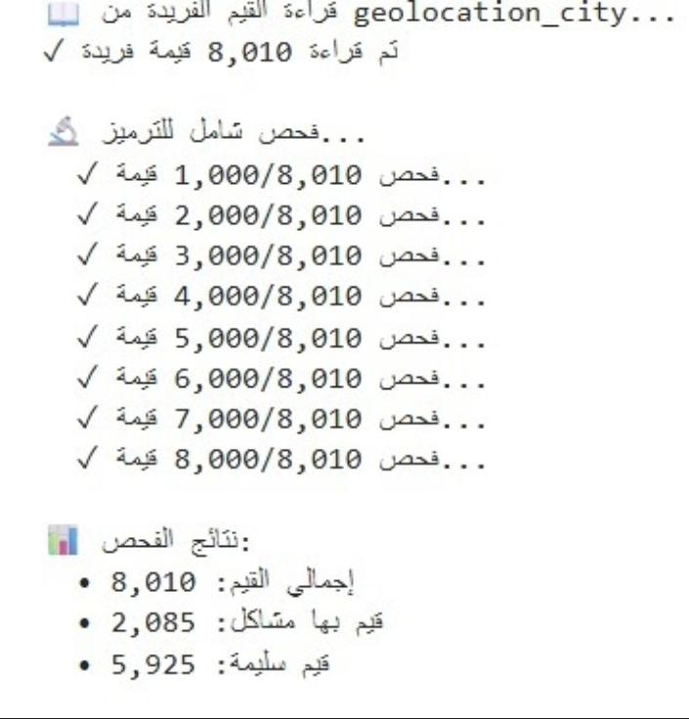
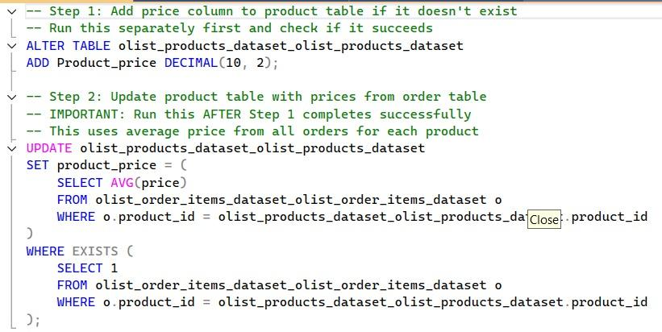
Data Cleaning

Slide 10
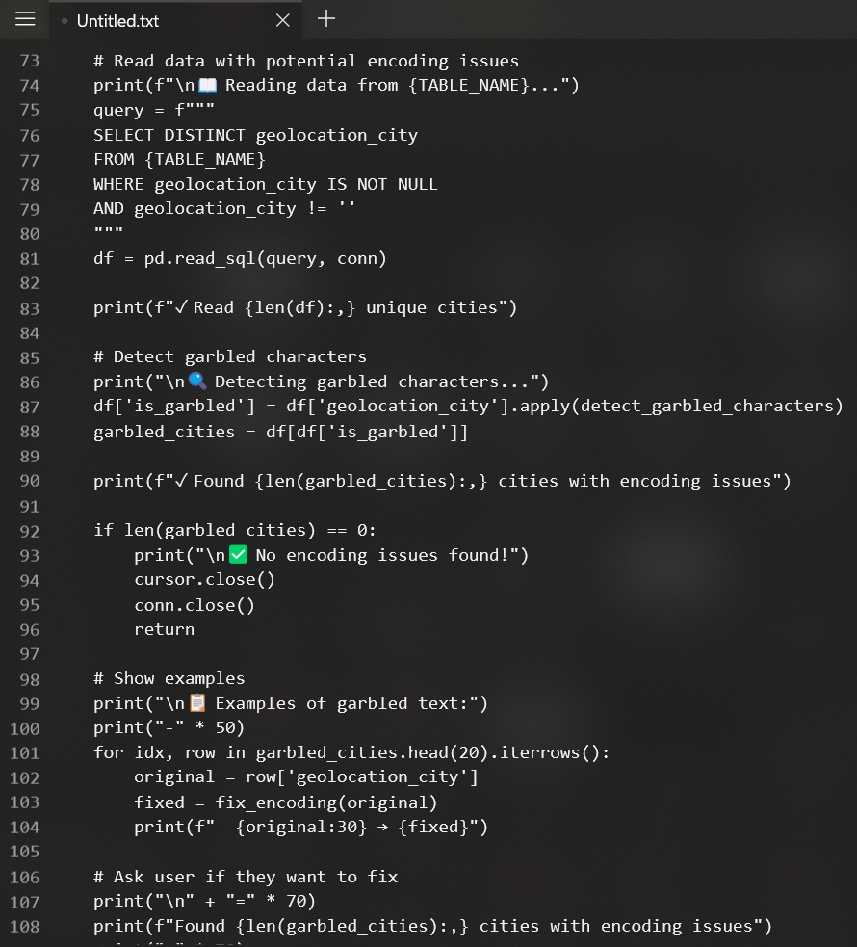
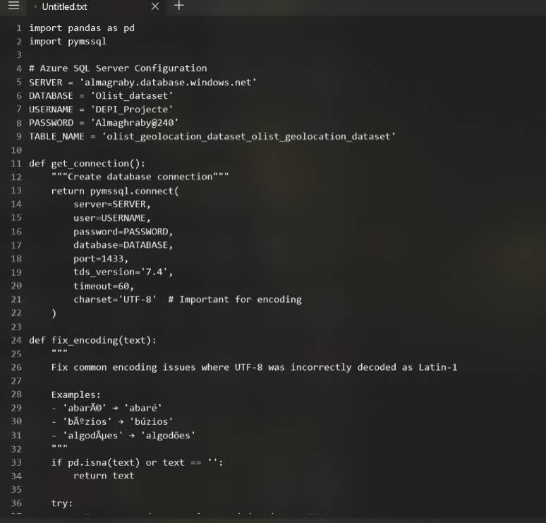
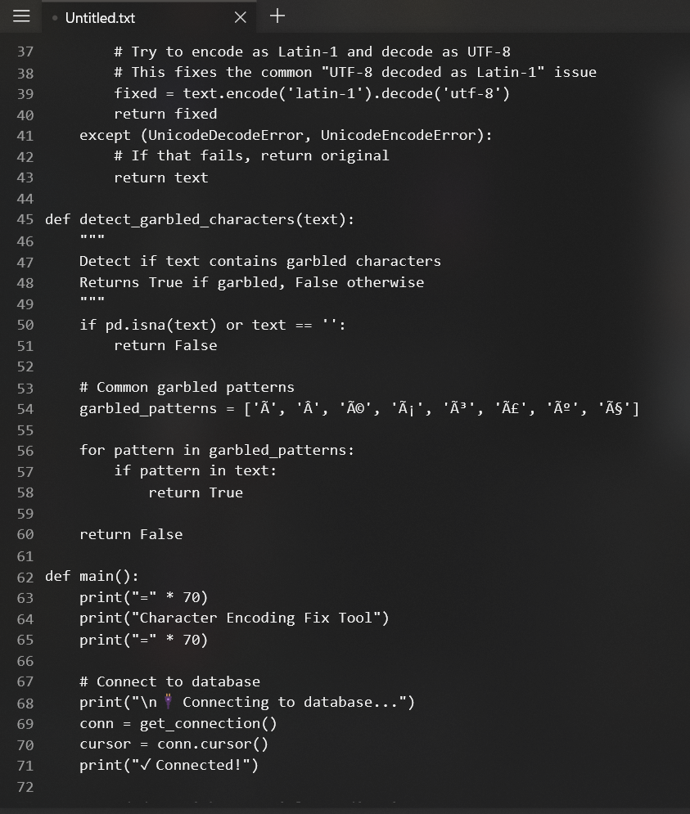
Data Cleaning

Slide 11
Measures selection
Data Cleaning Using SQL Server
In this project, selecting the right measures in Power BI was a crucial step to transform raw data into actionable insights. I carefully created essential calculations—such as performance metrics, totals, averages, ratios, and KPIs—to enable clear analysis, highlight key trends, support decision-making, and ensure the dashboard effectively communicates business performance to stakeholders using DAX functions .

Slide 12
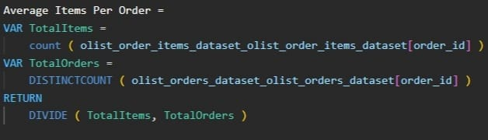
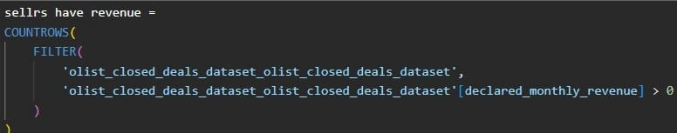
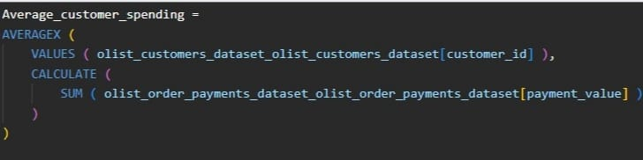
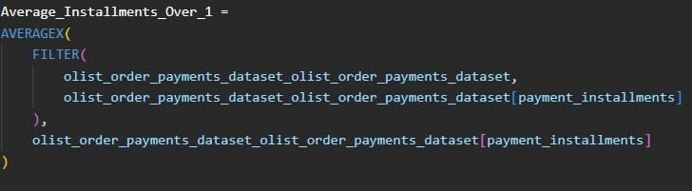
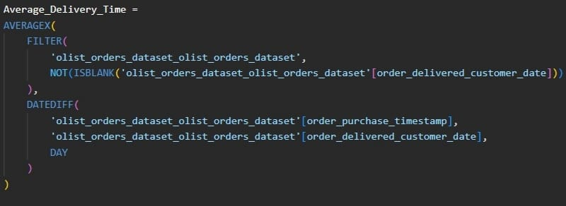
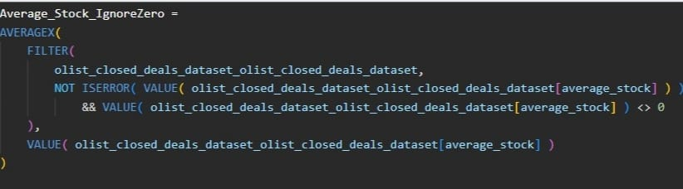
Measures selection

Slide 13
Visualization
In this project, designing effective visualizations in Power BI was essential to communicate insights clearly. I carefully selected charts, graphs, and tables that best represent the data, ensuring trends, patterns, and key metrics are easy to understand, enabling stakeholders to make informed decisions and enhancing the overall impact and usability of the dashboard.

Slide 14



Slide 15
Interpretation
In this project, interpreting the data in Power BI was a vital step to extract actionable insights. I analyzed the visualized metrics and trends to understand business performance, identify patterns, and highlight key opportunities. Clear interpretation ensures that stakeholders can make informed decisions, turning raw data and visualizations into meaningful conclusions that drive strategy and improvements.

Slide 16

DEPI

